Slide 1

Project Title – AIRBNB HOTEL BOOKING ANALYSIS
[Student Name: Mattaparthi Teja]
[AICTE Internship ID: STU660bdae81a4371712052968 ]

Slide 2

PROBLEM STATEMENT
To analyze Airbnb listings data to uncover trends and insights related to pricing, host behavior, property types, reviews, and availability, aiming to understand factors influencing bookings, reviews, and property performance.

Slide 3
Project Description:
The Airbnb Hotel Booking Analysis project is an exploratory data analysis (EDA) initiative aimed at uncovering key insights from Airbnb listings data. The project focuses on analyzing multiple aspects of Airbnb properties, including pricing, host characteristics, property types, reviews, and availability. By performing this analysis, the project provides valuable information for hosts to optimize their listings, for guests to make informed decisions, and for Airbnb management to better understand market trends

Slide 4

WHO ARE THE END USERS?
1. Airbnb Hosts
2. Airbnb Guests
3. Airbnb Management / Business Analysts
4. Data Analysts / Researchers

Slide 5

Technology Used:
Python: Main programming language for data analysis and visualization.
Pandas: Data manipulation, cleaning, and preprocessing.
NumPy: Numerical operations and calculations.
Matplotlib & Seaborn: Data visualization (bar charts, box plots, line plots, regression plots).
Google Colab: Development and interactive analysis environment.
Excel / CSV: Source data format for Airbnb listings.
Scikit-learn (if predictive analysis or correlation studies are performed).
Plotly / Seaborn advanced features for interactive visualizations.

Slide 6
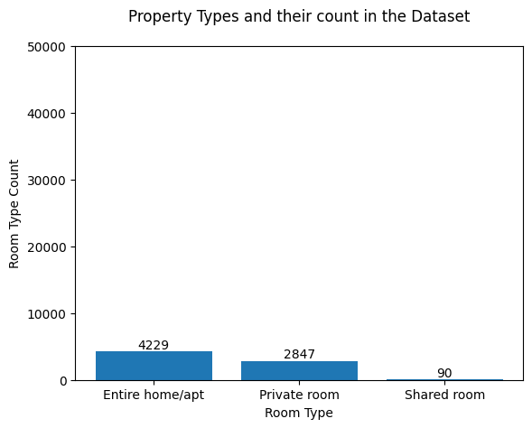
RESULTS1

Slide 7
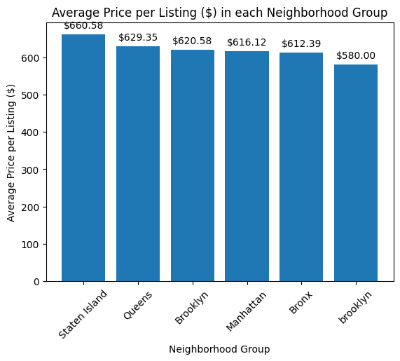
RESULTS2
Demo Link

Slide 8
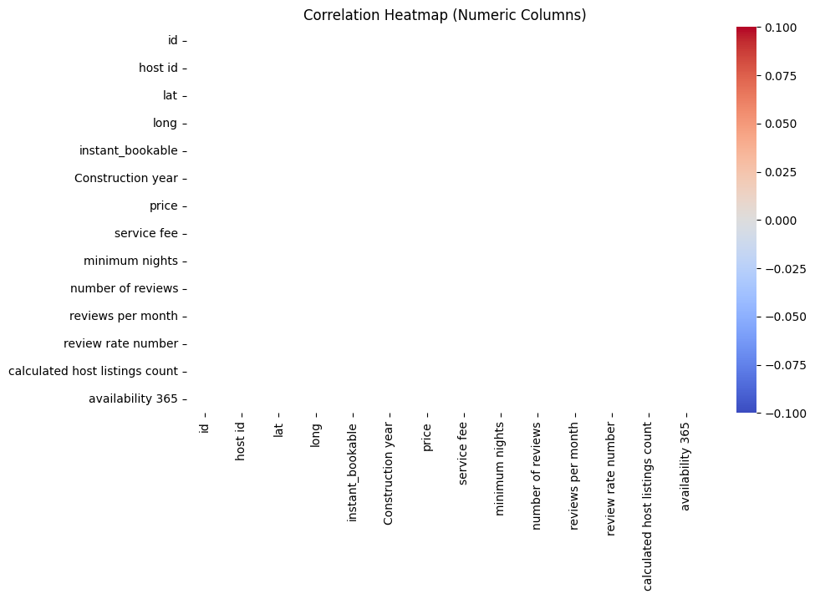
Result4:

Slide 9
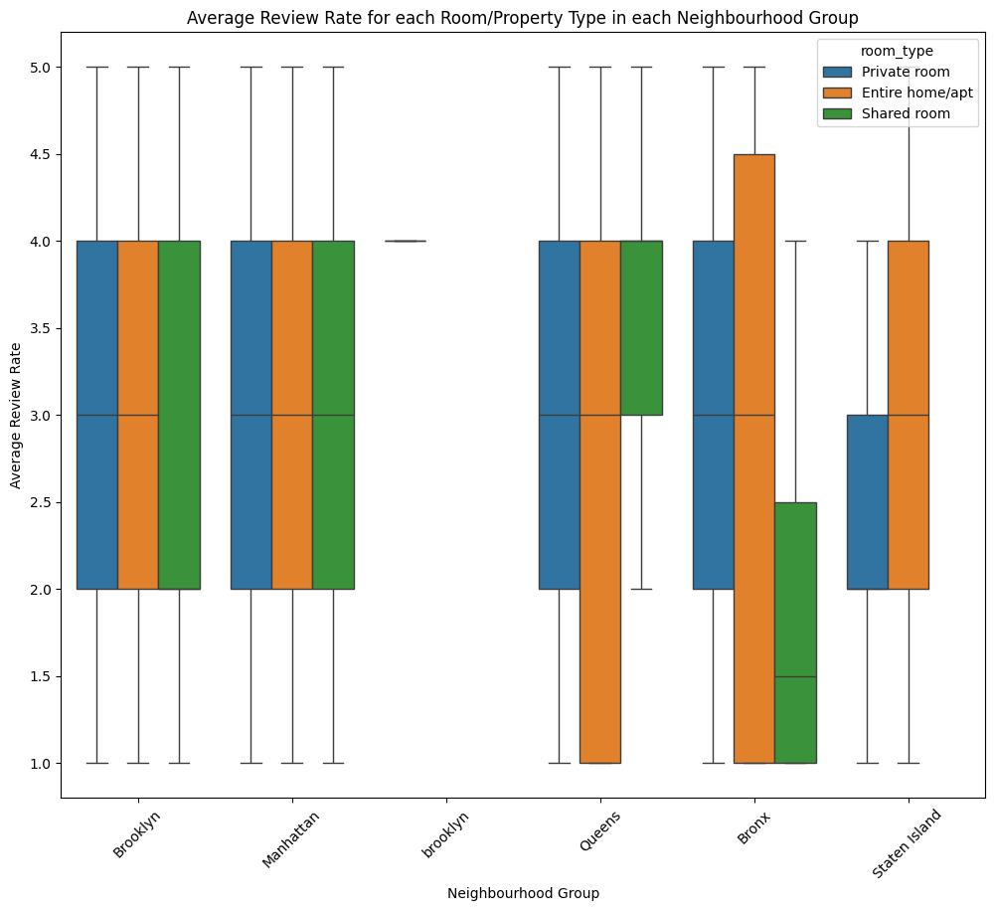
RESULTS3
Demo Link

Slide 10
GitHub repository
GitHub Repository Link/URL:
https://github.com/Teja1123-alt/VOIS_AICTE_OCT2025_MATTAPARTHI_TEJA
Demo Link

Slide 11
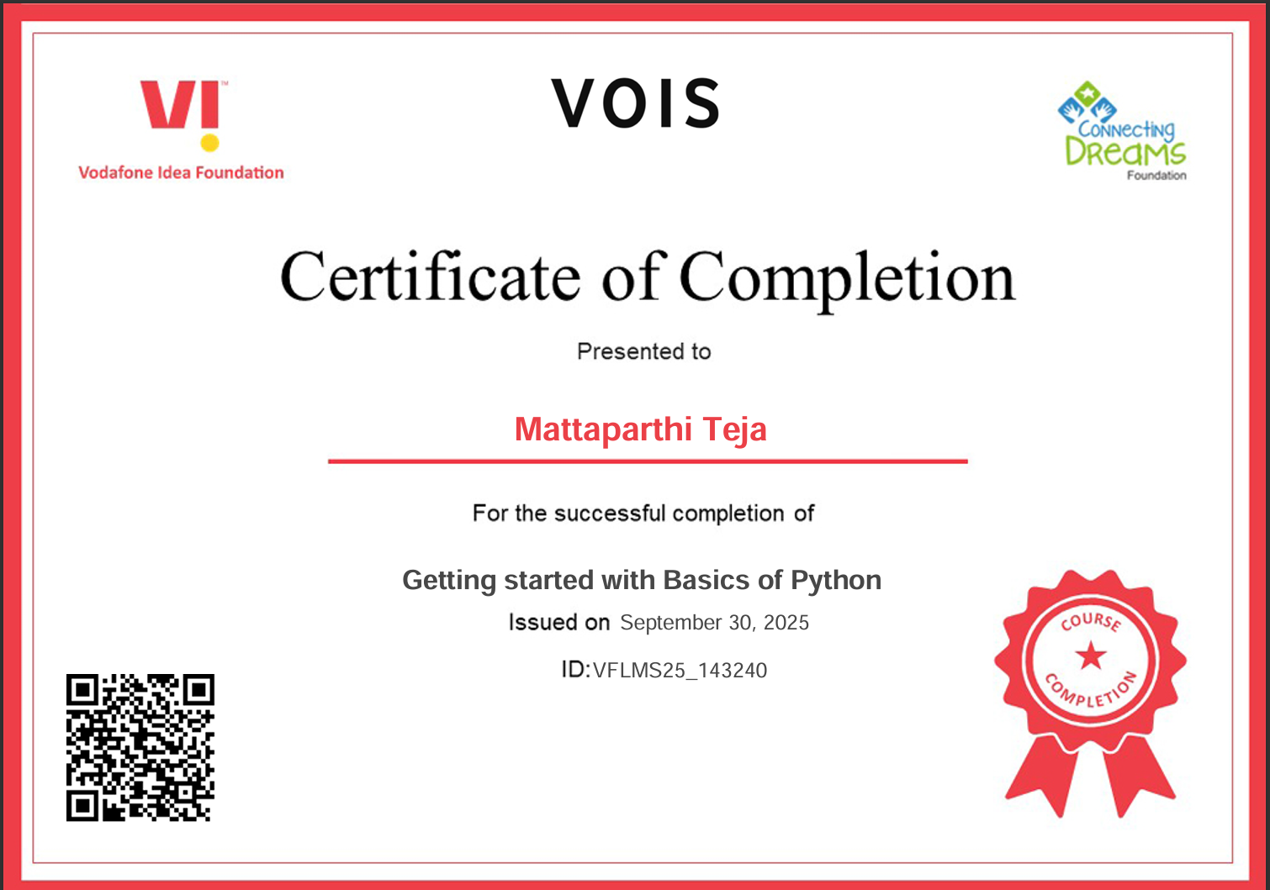
Getting started with Basics of Python Certificate

Slide 12
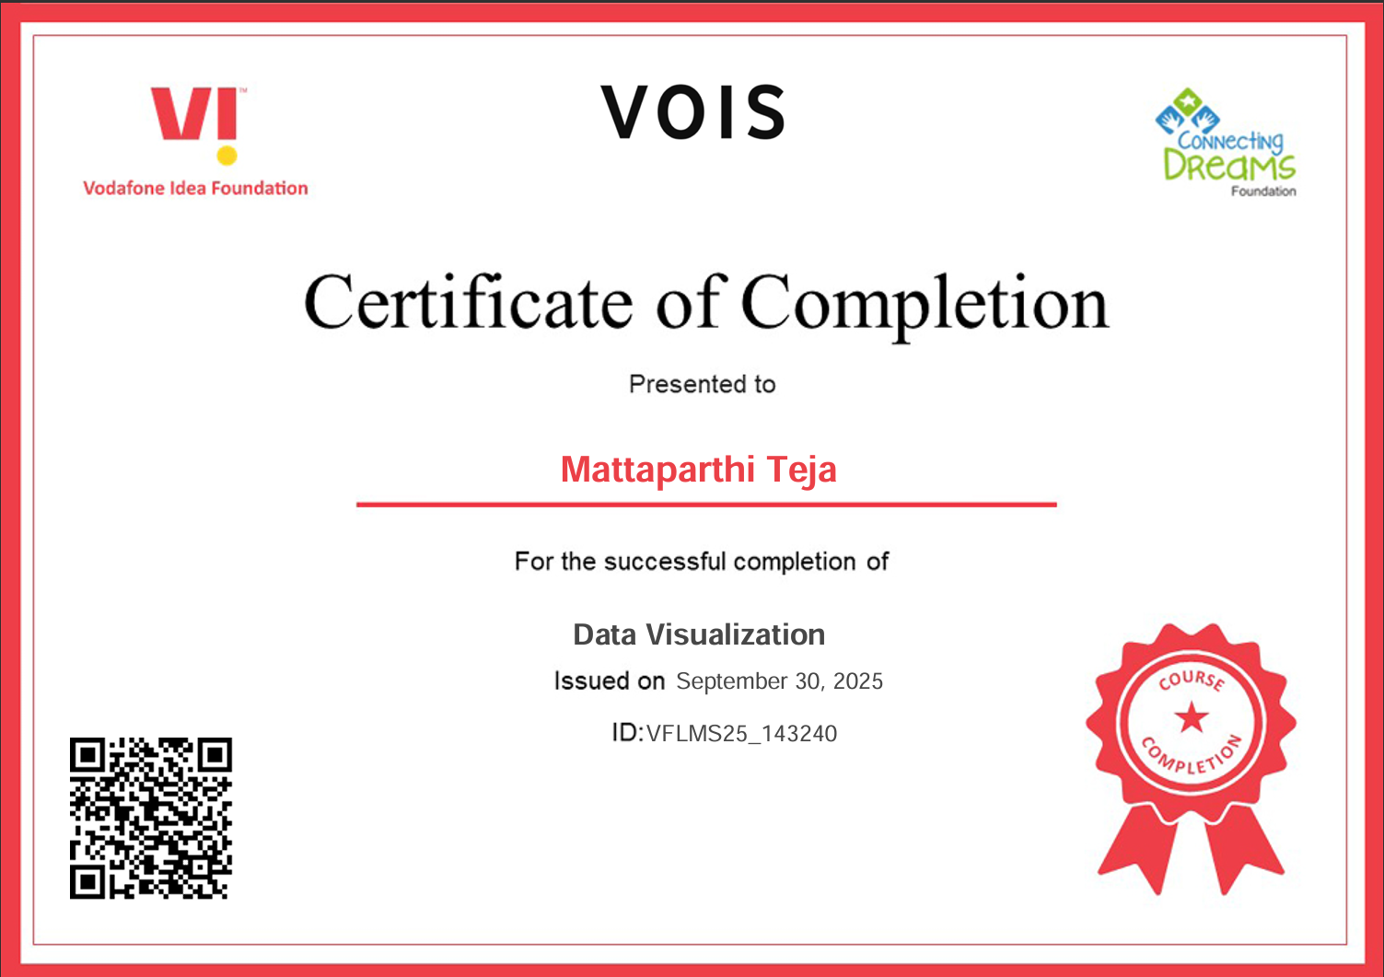
Data Visualization Certificate

Slide 13
Thank you
.
.

